Slide 1
Class Format
Synchronous vs. Asynchronous
Local (In Person) vs Remote
We are synchronous.
We will be in person on Mondays and Wednesdays and remote on Fridays.
You will be here in person on Mondays and Wednesdays. Periodically, if you need to be remote on Monday or Wednesday, we understand, but please keep it to a minimum and appreciate of your teammates.
Priorities:
Health and Safety
Effective teaming and association
Intended course schedule

Slide 2
Class Format
Blended Classroom… sometimes referred to as Flipped Classroom
Scrum Process

Slide 3
Sprint 1 Planning (abbreviated)
Blackboard Shell
Activities: What we do to gain knowledge
Syllabus: Book
Assignments: What we do to demonstrate knowledge
Sprint 1 Due Date
Prework for Wednesday
Our Goal: Complete introductions, scrum team assignments, and be ready to participate in an all remote Scrum Team breakout session Friday.

Slide 4
Introductions

Slide 5
Foreshadowing Your Introductions
Be prepared to share your:
Preferred name and seat number
Major / Minor
Programming Experience (1 to 5)
An interesting fun fact about yourself
Favorite “adjective/noun” scrum team name

Slide 6
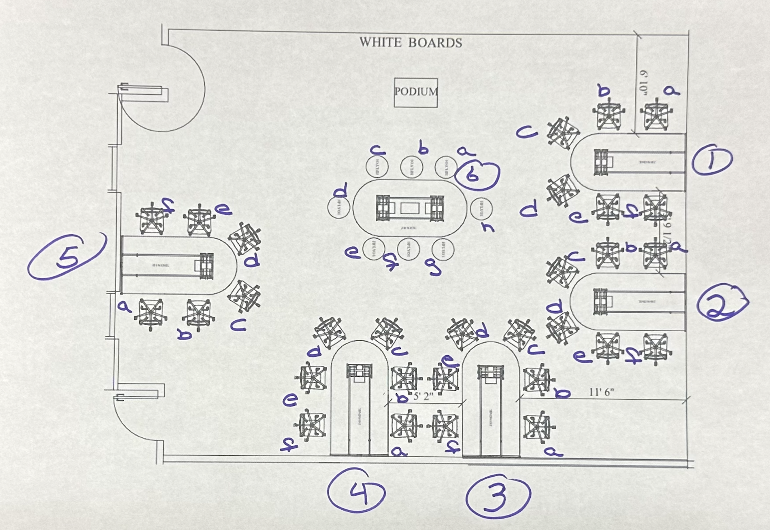
Your Introductions
Be prepared to share your:
Preferred Name, Seat, and Row Number
Major / Minor
Programming Experience (0 to 5)
An interesting fun fact about yourself
Are you willing to be the Scrum Master
Favorite “adjective/noun” scrum team name

Slide 7
Seat

Slide 8
Row?

Slide 9
Scrum Team Names
Scrum team names from previous semesters:
EZScrumEZGo
SourPatchEngineers
DreamRaccoons
TeamFun
SwagMoney
MonaLisas
Scrumdiddlyumptious
FightingBass
TitanicSwimTeam
GloriousKenobis
RedDragons
ScrumciousCoders
Mongooses
Scrumples
WubbaLubbaDubDubs
RedPandas
SpiderScrum
MadSanitizers
SpeedCoders
StingyTadpoles
BlueThrees
PurpleCobras
ScruptyDupty
LaughableCaterpillars
PurplePirates
ScrumIsFum
ScrummyScrumbags
TheCrew
WickedCrew
SpicyChalupas
ScrumOfTheEarth
LightningMcQueen
Notes:
Hand out name tags and introduction forms before Syllabus Overview

Slide 10
Introductions – Part 1

Slide 11
Introductions
Full and Preferred Name:
Eric Pogue
Eric, Mr. Pogue, or Professor
Family, Home, and College Background:
Married with five children, relocated from Davenport, IA, to the Chicago area
Undergraduate in CS and Masters in Business… teaching evenings for many years
Programming experience:
Decades in the industry as a developer, architect, project manager, division manager, and vice president of various software development organizations
Part of many teams that have delivered products to tens of millions of customers globally
Parsons Technology, Intuit, The Learning Company, Jasc Software, and John Deere
… and most recently, working on a startup product, “Stadia,” with my oldest son
Start of my fourth year teaching full-time

Slide 12


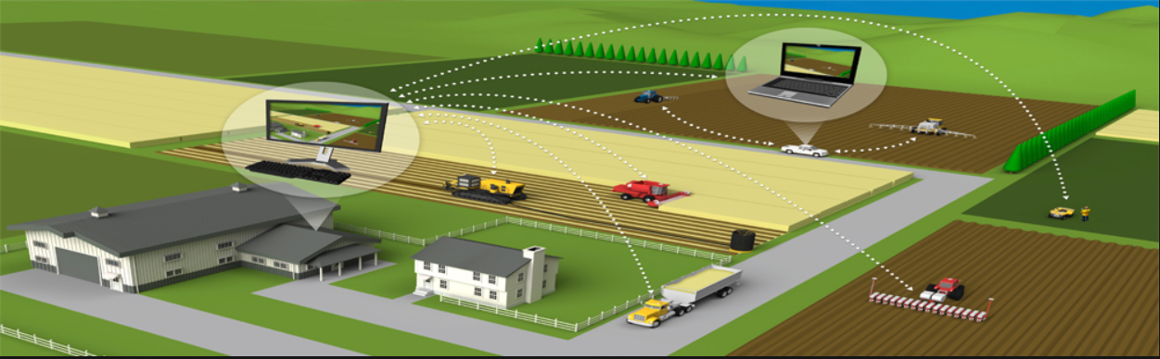





Slide 13
Introductions
Likely programming environment
MacOS, Terminal, Visual Studio Code, and Chrome/Firefox web browser
Top two or three things that you would like to get out of this class
To learn something myself while helping each of you be successful
Motivate you to look deeper while we are exploring technologies and processes
Help you build something that makes you proud
Hobbies:
Wilderness Canoeing & Camping (Quetico) and Triathlons
Fun Fact:
At one point, I had the very dubious “honor” or being the most traveled John Deere employee to India with 40+ trips over a 5-6 year period while setting up the 400+ person John Deere Technology Center – India Software Development organization.
Notes:
Vanity

Slide 14
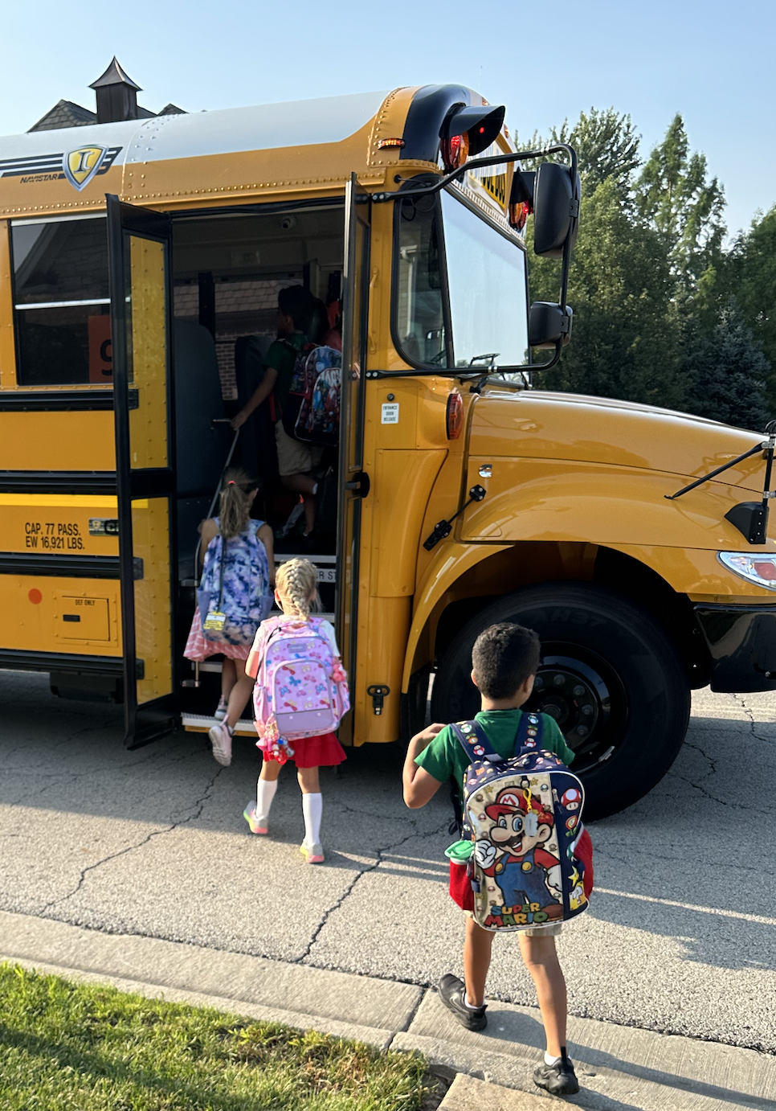
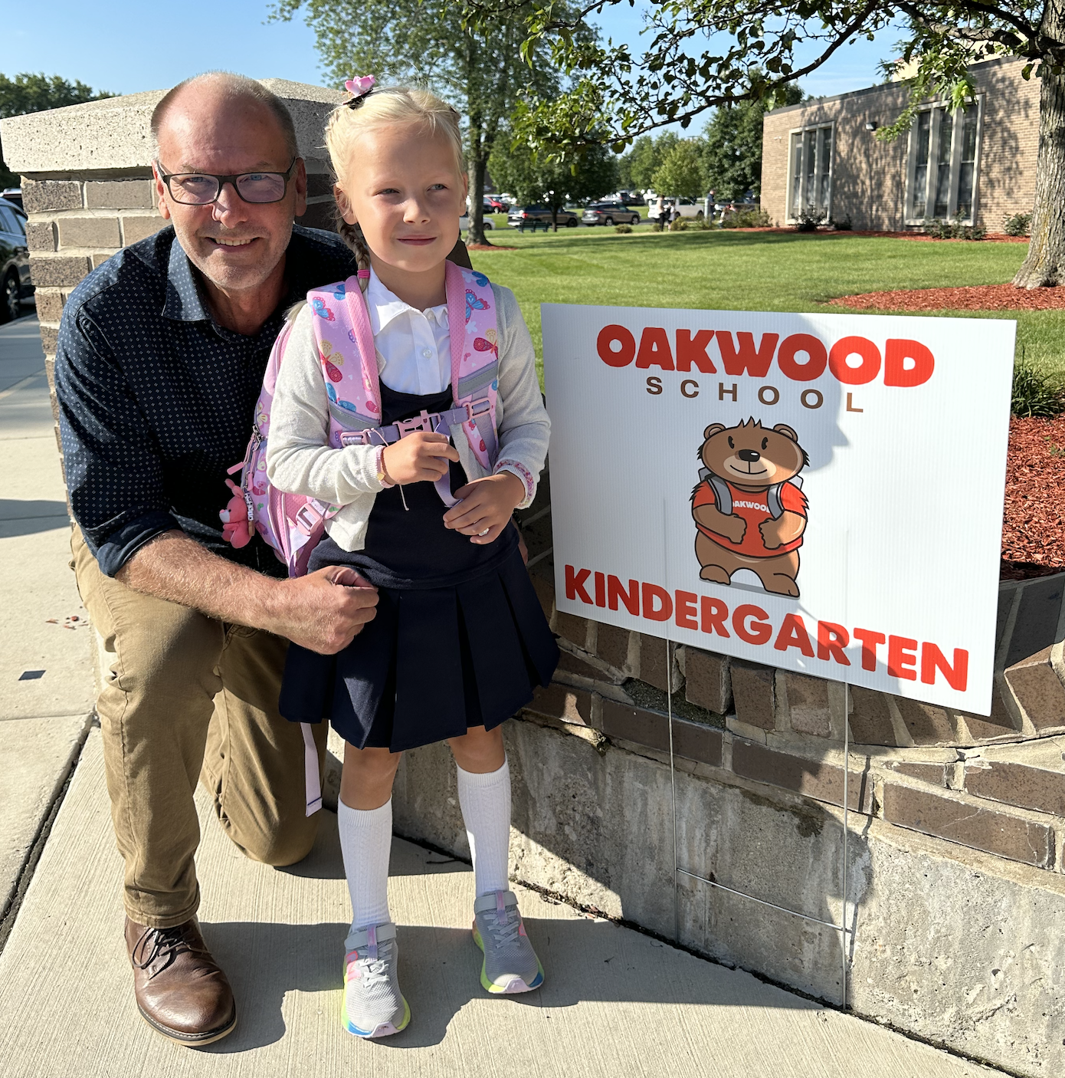
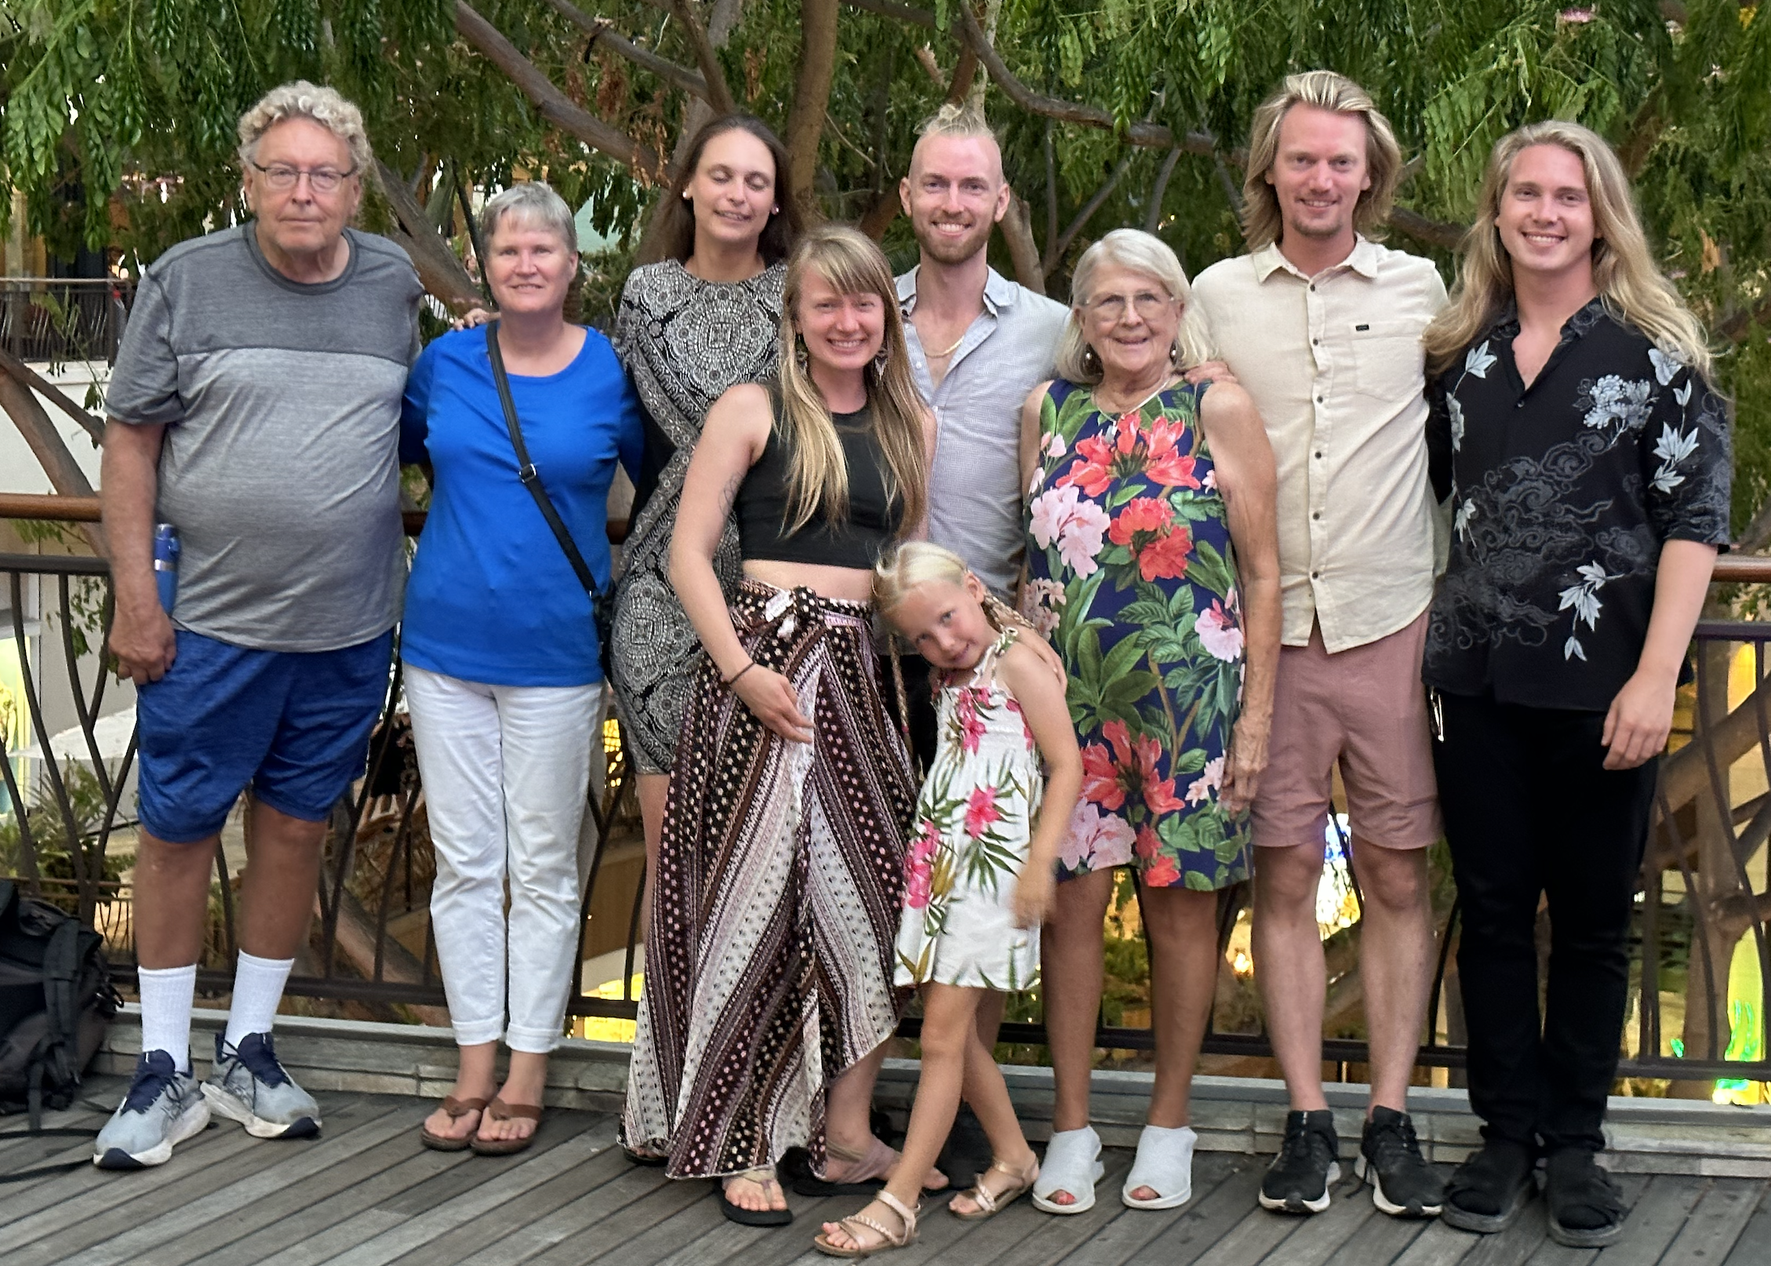


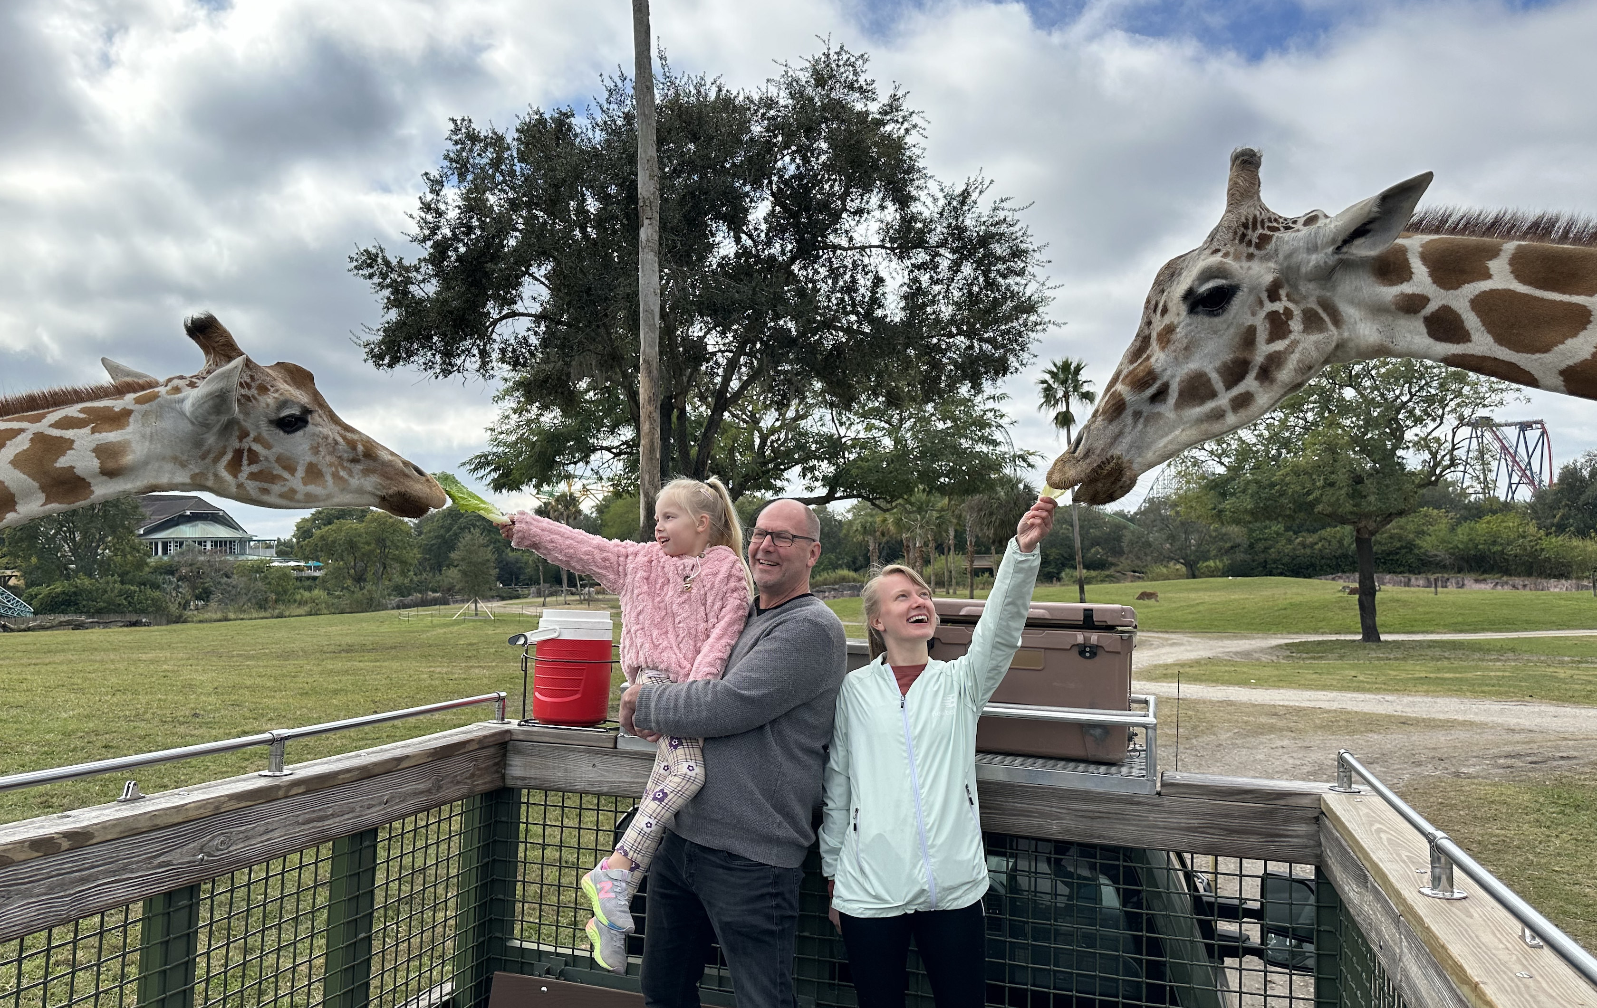
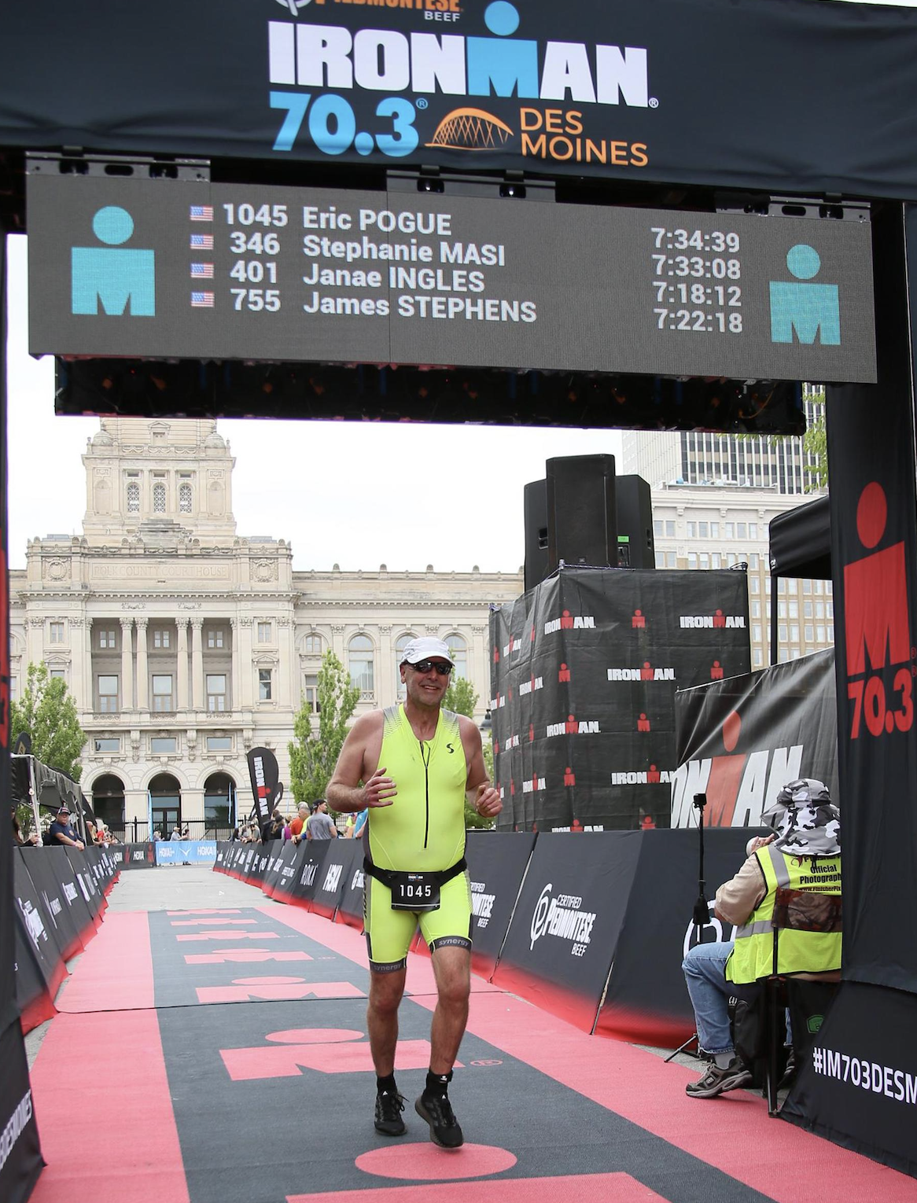

Slide 15
Sprint 1 Planning (abbreviated)

Slide 16
Sprint Planning
We will be doing sprint planning at the beginning of each of our 8 sprints during the semester.
What’s different about Sprint 1 planning?
We will need to finish Sprint 1 planning on Wednesday because we want to make sure that we have time for Introductions and initial Scrum Team assignments today
Next Monday is a Holiday, so we will be missing one class session this sprint

Slide 17
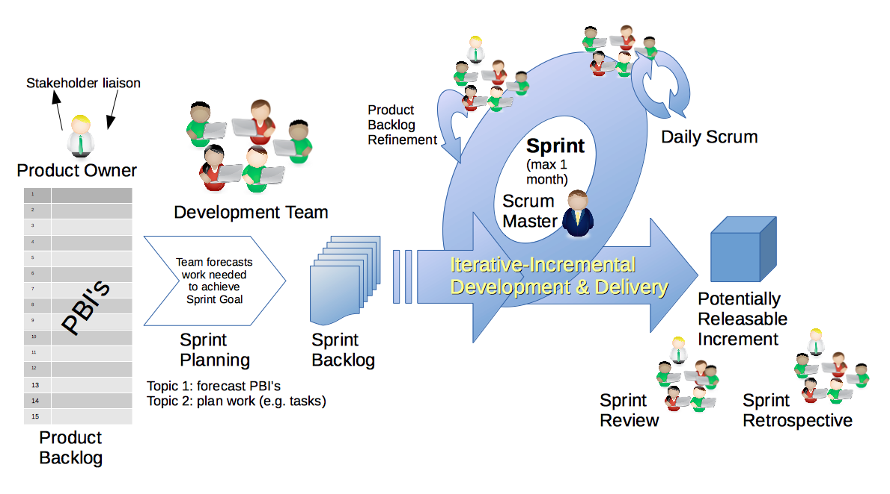
Scrum Process – Sprint Planning
By Dr ian mitchell - Own work, CC BY-SA 4.0, Link

Slide 18
Review Announcement, Activities List,
Assignments, and Syllabus

Slide 19
Sprint Planning
(to be continued Friday)

Slide 20
Introductions – Part 2

Slide 21
Scrum Team Names
Scrum team names from previous semesters:
EZScrumEZGo
SourPatchEngineers
DreamRaccoons
TeamFun
SwagMoney
MonaLisas
Scrumdiddlyumptious
FightingBass
TitanicSwimTeam
GloriousKenobis
RedDragons
ScrumciousCoders
Mongooses
Scrumples
WubbaLubbaDubDubs
RedPandas
SpiderScrum
MadSanitizers
SpeedCoders
StingyTadpoles
BlueThrees
PurpleCobras
ScruptyDupty
LaughableCaterpillars
PurplePirates
ScrumIsFum
ScrummyScrumbags
TheCrew
WickedCrew
SpicyChalupas
ScrumOfTheEarth
LightningMcQueen
Notes:
Hand out name tags and introduction forms before Syllabus Overview

Slide 22
Your Introductions
Be prepared to share your:
Preferred Name, Seat, and Row Number
Major / Minor
Programming Experience (0 to 5)
An interesting fun fact about yourself
Are you willing to be the Scrum Master
Favorite “adjective/noun” scrum team name

Slide 23
End of Session

